Slide 1


WEB FUNDEMENTALS HTML

Slide 2


HTML IS NOT A PROGRAMMING LANGUAGE
IT IS USED TO DEFINE STRUCTURE OF A WEB PAGE NOT THE FUNCTION. IT CONTAINS NO PROGRAMMING LOGIC

Slide 3
WHAT IS HTML?
HYPER TEXT MARKUP LANGUAGE
DESCRIBES THE STRUCTURE OF A WEB PAGE USING MARKUP (CODE FOR FORMATTING THE LAYOUT AND STYLE OF
ELEMENTS IN THE FORM OF TAGS)
Notes:
Describes the structure of a webpage using markup
Is the standard markup language for creating web pages
Elements are the buiding blocks of HTML web pages which are represented by tags to achieve font, colour, graphic and hyperlink effects on the web pages
Tags are not displayed on a webpage but render the content of the page

Slide 4
WHAT ARE TAGS?
TAGS DEFINE PIECES OF CONTENT ON A WEB PAGE
E.G. PARAGRAPHS, HEADINGS, IMAGES, LINKS, ETC.
<tag>…</tag>
Notes:
Define pieces of content on a web page
Defined within <>
Opening and closing tag

Slide 5
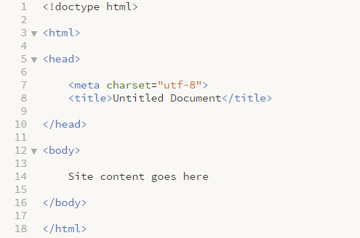
BASIC HTML STRUCTURE
<head></head>
Provides general information about the document (metadata)
<body></body>
Defines the body of the document (content)
Notes:
Show examples of tags
<!doctype html>
is not a tag but rather an instruction to the browser stating which version of HTML the page is written in - HTML5
HTML 4.01 had variations but HTML5 only has one
<html>
the root of an HTML document and tells the browser that the document is HTML
contains all HTML elements
<head>
contains general, behind the scenes information related to the document
contains all head elements
title, scripts, styles, meta data, etc.
charset – character encoding for the HTML document, UTF-8 is capable of encoding all possible characters and is the preferred encoding for web pages
<body>
defines the document’s body and contains all the content of an HTML document
hyperlinks, images, tables, lists, paragraphs, etc.

Slide 6
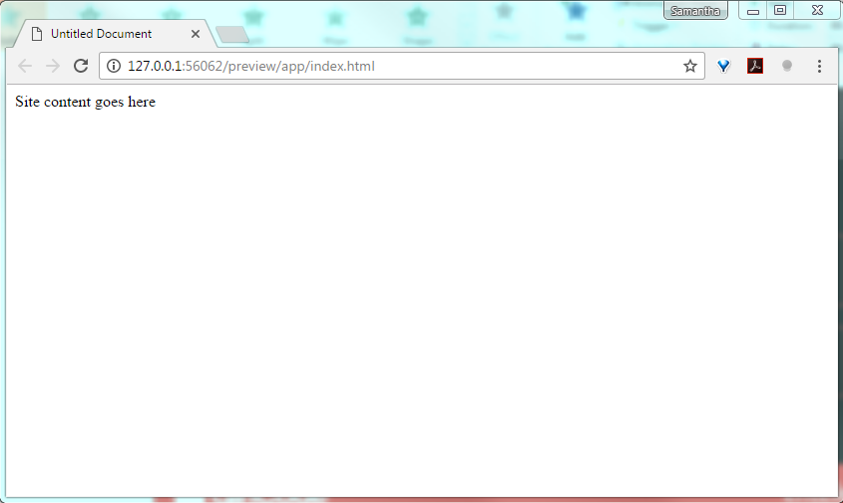
BASIC HTML STRUCTURE: RESULT

Slide 7
HTML vs. HTML5 TAGS
<div id=“header”>
<header>
<div id=“nav”>
<nav>
<div id=“section”>
<section>
<div id=“aside”>
<aside>
<div id=“article”>
<article>
<div id=“footer”>
<footer>
Notes:
HTML5 introduced new semantic elements to simplify and better describe content contained within an element
Previous use of div was not very descriptive
Cleaner, nicer looking code

Slide 8
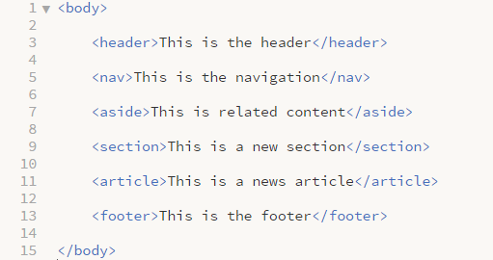
HTML STRUCTURE
<header>
<nav>
<section>
<aside>
<article>
<footer>
Notes:
Discuss code

Slide 9
COMMONLY USED TAGS: CONTAINERS
TAG | TAG DESCRIPTION
<header></header> | Defines the header portion of the page
<footer></footer> | Defines the footer portion of the page
<nav></nav> | Defines the navigation portion of the page
<section></section> | Defines a section of the page
<article></article> | Defines a self contained article
<main></main> | Defines the main content portion of the page
<aside></aside> | Defines a portion of the page related to the main content
<div></div> | Defines a generic section of the page
<hr> | Defines a thematic change – draws a horizontal line

Slide 10
COMMONLY USED TAGS: FORMATTING
TAG | TAG DESCRIPTION
<h1></h1> | Defines a heading: <h1> - <h6>
<p></p> | Defines a paragraph
<blockquote></blockquote/> | Defines a quotation
<em></em> | Italic
<strong></strong> | Bold
<br/> | Inserts a single line break
<ol>ol> | Defines an ordered list (1,2,3)
<ul></ul> | Defines an unordered list (Bulleted)
<li></li> | Defines an item within a list

Slide 11
COMMONLY USED TAGS: FORMATTING
TAG | TAG DESCRIPTION
<table></table> | Defines a table with 1 row (tr) and 1 col (td)
<tr></tr> | Defines a new row of a table
<th></th> | Defines the heading column of a table
<td></td> | Defines a standard column of a table
<a></a> | Defines an anchor, usually to add a link
<img> | Defines an image
<span></span> | Groups inline elements

Slide 12
HTML ATTRIBUTES
ALL HTML ELEMENTS CAN CONTAIN ATTRIBUTES WHICH
PROVIDE EXTRA INFORMATION ABOUT THE ELEMENT
<tag attribute name = “value”>…</tag>
Notes:
Extra information can be added to HTML elements or tags by using attributes
Width, height, classes and id’s, external source files, links, etc.
State attribute name = “value”, double quotations are preferred practise

Slide 13
COMMON HTML ATTRIBUTES
ATTRIBUTE | ATTRIBUTE DESCRIPTION
title | Title value will be displayed as a tooltip on mouse over
href | Specifies the link address within an anchor tag
width, height | Specifies an element’s width and height
alt | Specifies an alternative text to be used when an element can’t be displayed
id | Unique selector.
class | Non-unique selector
src | Points to an external file (source file)
target | Specifies where to open the linked document

Slide 14
ID’S AND CLASSES
ID’S AND CLASSES ARE BOTH SELECTORS
ID’S ARE UNIQUE, THE VALUE MAY ONLY BE USED ONCE
WITHIN THE DOCUMENT
CLASSES ARE NOT UNIQUE, A SINGLE CLASS MAY BE USED
FOR MULTIPLE ELEMENTS IN THE DOCUMENT
Notes:
Selectors
Id’s are unique
Classes are not unique

Slide 15
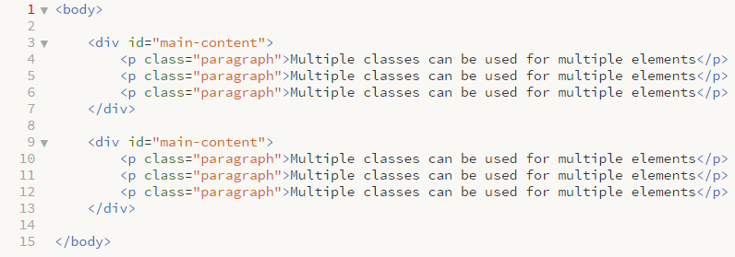
ID’S AND CLASSES
Notes:
- Can’t use the same div twice

Slide 16
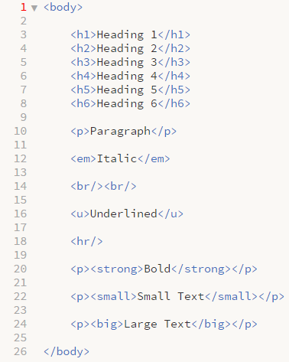
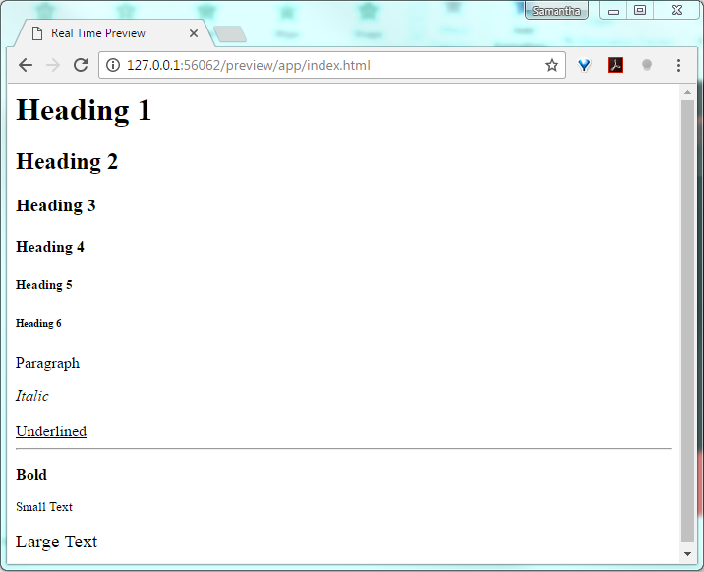
EXAMPLE: TEXT FORMATTING

Slide 17

EXAMPLE: IMAGES

Slide 18

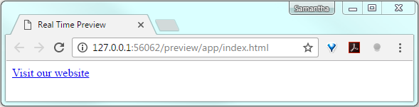
EXAMPLE: LINKS

Slide 19
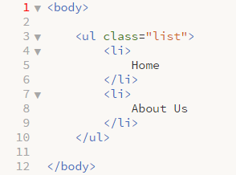
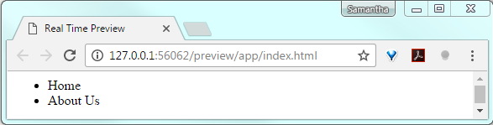
EXAMPLE: UNORDERED LISTS

Slide 20
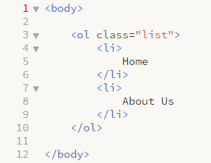
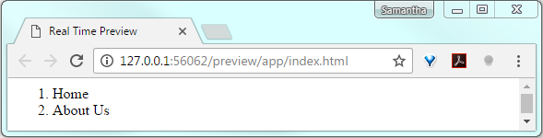
EXAMPLE: ORDERED LISTS

Slide 21
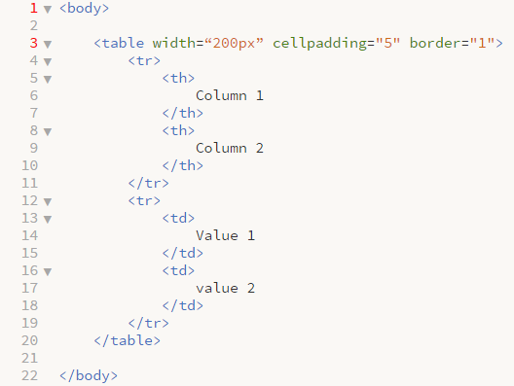
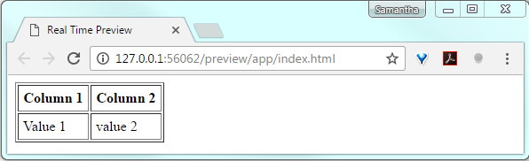
EXAMPLE: TABLES

Slide 22
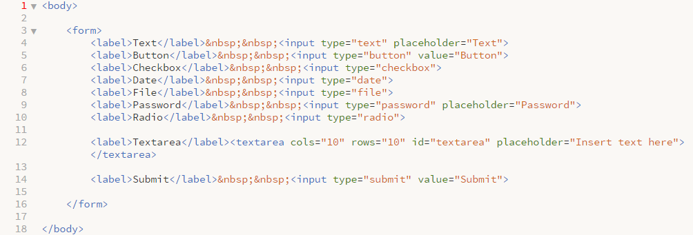
EXAMPLE: FORMS

Slide 23
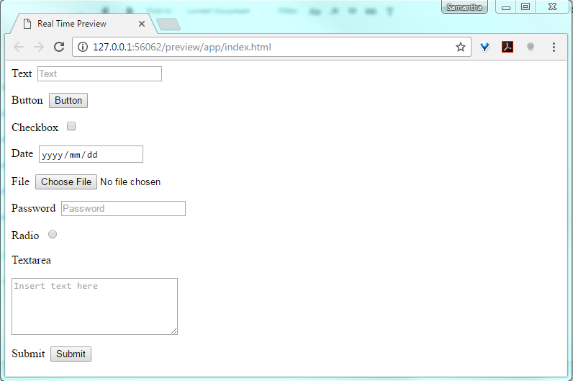
EXAMPLE: FORMS

Slide 24
BLOCK & INLINE ELEMENTS
BLOCK LEVEL ELEMENTS ALWAYS START ON A NEW LINE AND TAKE UP THE FULL WIDTH OF THEIR CONTAINER
<div>, <h1> - <h6>, <p>, <form>
INLINE ELEMENTS DO NOT START ON A NEW LINE AND ONLY TAKE UP AS MUCH SPACE AS IS NECESSARY
<span>, <a>, <img>

Slide 25
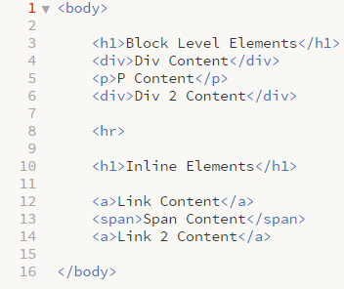
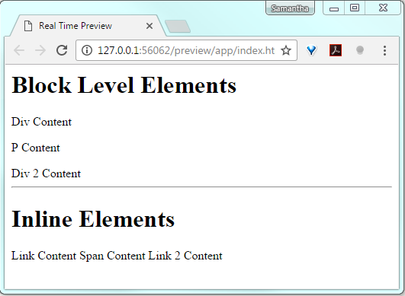
EXAMPLE: BLOCK & INLINE ELEMENTS

Slide 26
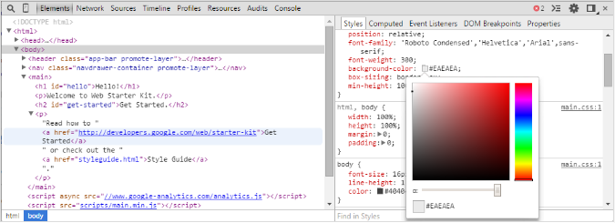
DEVTOOLS
Notes:
Demo

Slide 27
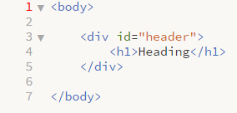
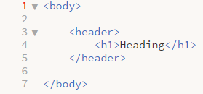
GOOD VS. BAD CODE
DESCRIPTIVE BLOCKS DESCRIBING CONTENT CONTAINED

Slide 28
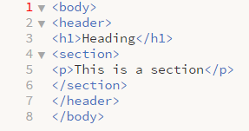
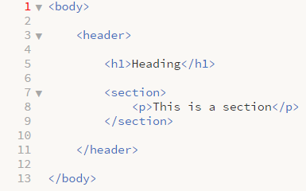
GOOD VS. BAD CODE
INDENTATION TO DECIFER PARENT CHILD RELATIONSHIPS

Slide 29
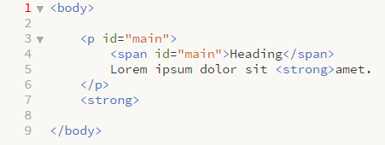
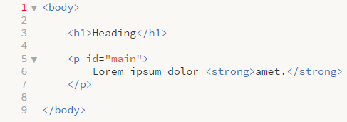
GOOD VS. BAD CODE
USE OF AN ID TWICE, HEADING NOT IN A HEADING TAG AND
INCORRECT ORDERING OF TAGS

Slide 30
HTML5
NEW SEMANTIC ELEMENTS <header>, <footer>, <nav>, ETC.
NEW ATTRIBUTES NUMBER, DATE, TIME, CALENDAR AND RANGE
NEW GRAPHIC ELEMENTS <svg> AND <video>
NEW MULTIMEDIA ELEMENTS <audio> AND <video>
GEOLOCATION
DRAG AND DROP
LOCAL STORAGE
APPLICATION CACHE
WEB WORKERS
SSE

Slide 31

QUESTIONS?

Slide 32
REFERENCES
https://css-tricks.com/examples/CleanCode/Beautiful-HTML.png
https://www.w3.org/International/questions/qa-what-is-encoding
http://webdesignfromscratch.com/html-from-scratch/
https://www.w3schools.com
http://www.danfergusdesign.com/classfiles/generalReference/html5reference.php
https://developer.mozilla.org/en/docs/Web/HTML/Element/head
https://css-tricks.com/the-difference-between-id-and-class/
https://developer.chrome.com/devtools
https://developer.mozilla.org/en/docs/Web/Guide/HTML/HTML5
http://www.webstepbook.com/supplements/slides/ch08-dom.shtml
http://memeshare.xyz/media/html-memes

Slide 33
PRACTISE EXERCISE: RESUME
CREATE A SINGLE PAGE ONLINE RESUME CONTAINING THE FOLLOWING:
A HEADER CONTAINING YOUR NAME
A SECTION FOR YOUR PROFILE PICTURE AND ANY OTHER INFO YOU MAY LIKE TO ADD
A SECTION FOR YOUR RESUME CONTENT CONTAINING THE FOLLOWING:
AT LEAST 1 HEADING
MAIN RESUME CONTENT
A LIST
A FOOTER WITH YOUR CONTACT DETAILS

